Slide 1
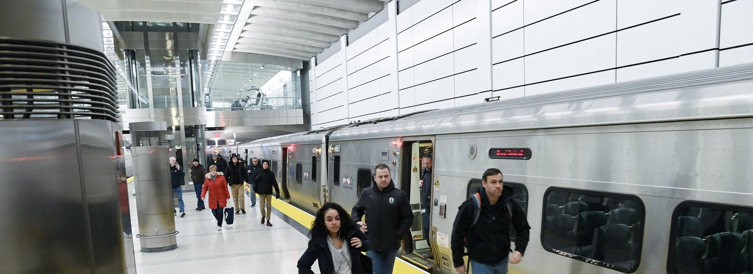



MTA
“The Metropolitan Transportation Authority”

Slide 2

Content :
Team
Introduction & project objectives
Dataset Overview
Project Building
Key Insights

Slide 3


Team
1- Mohamed Fathy.
2- Mostafa Gamal.
3- Zenib Ibrahim.
4- Hazem.
5- Esraa ElMalawy.
6- Abanob Samir.

Slide 4
Introduction
The Metropolitan Transportation Authority (MTA) is the largest transit network in North America.
It serves 12 counties in southeastern New York and 2 in Connecticut. Includes subway, bus, commuter rail, paratransit, and bridges/tunnels.
Our project is studying the effect of covid-19 on MTA companies.

Slide 5

Project Objective
Analyze MTA ridership trends pre- and post-pandemic.
Identify recovery patterns and peak ridership times.
Provide insights for future transportation planning.

Slide 6

Dataset Overview
MTA Daily Ridership Data (CSV) Contain Comparison between Pre-pandemic vs. Post-pandemic ridership for:
- Subway (NYCT)
- Buses ( MTABC)
- Long Island Rail Road (LIRR)
- Metro-North Railroad (MNR)
- Bridges and Tunnels (B&T)
- Staten Island Railway (SIR)
NYC COVID-19 Cases ( XLSX)
Ticket Revenue Data (XLSX)

Slide 7
Dataset Overview
Data Collection Methodology:
Subway and bus ridership data from MetroCard/OMNY transactions.
LIRR and Metro-North ridership is estimated by a model using monthly, weekly, ten-trip, and daily ticket sales.
The Access-A-Ride ridership within this dataset is a measure of scheduled trips as an indicator of demand
Bridges and Tunnels data comprises of preliminary total traffic volume collected by the toll collection systems at the 7 MTA bridge and 2 tunnel crossings.

Slide 8
Project Building
1- Data Cleaning steps:
Loaded data from multiple sources.
Removed duplicate and unnecessary columns.
Handled missing values.
Formatted date and numerical fields.
Created calculated columns for analysis
Standardized date and time formats.
2- Data modeling for power bi steps:
Created new calculated fields using DAX
Created relation between tables
2- Visuals :

Slide 9
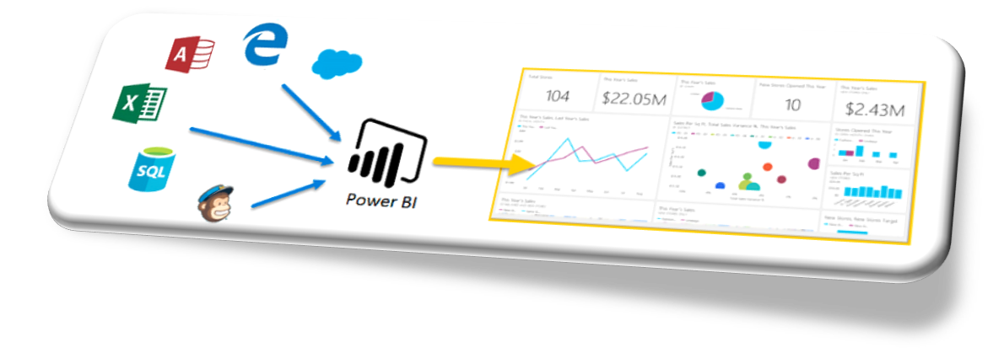
Project Building
3- Visuals :
Line Charts – Showed ridership trends over time.
Bar Charts – Compared different MTA services.
KPI Cards – Highlighted key statistics.
Pie charts.
Callender.
Slicers.
Multicard

Slide 10
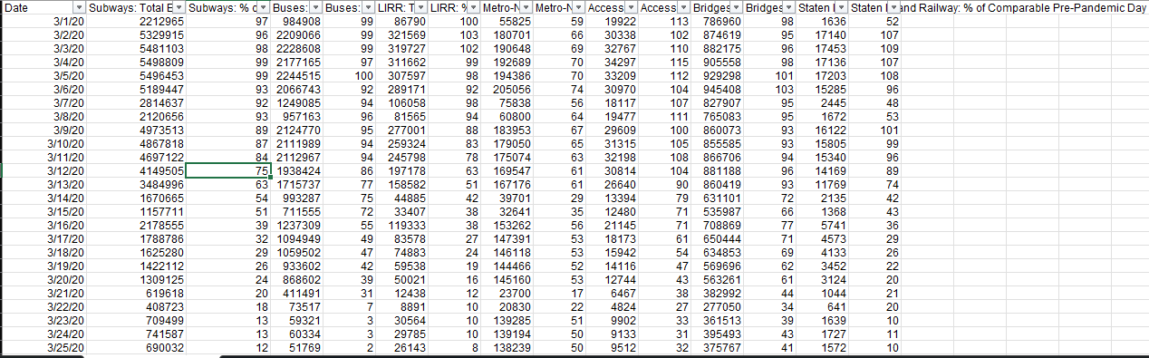
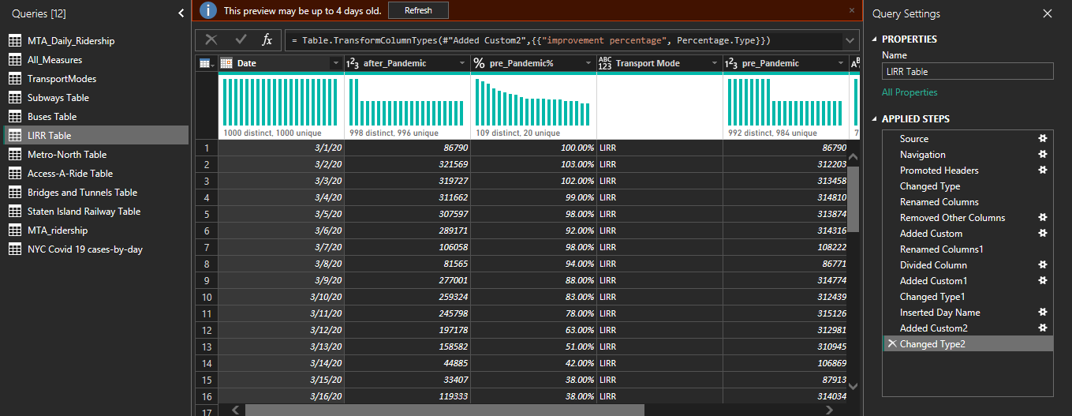
Project Building: 1- Data Cleaning & modeling & DAXs
- Data Cleaning
- Table Cutting
- Create Column in PQ
- Create relations
- Create Measures

Slide 11
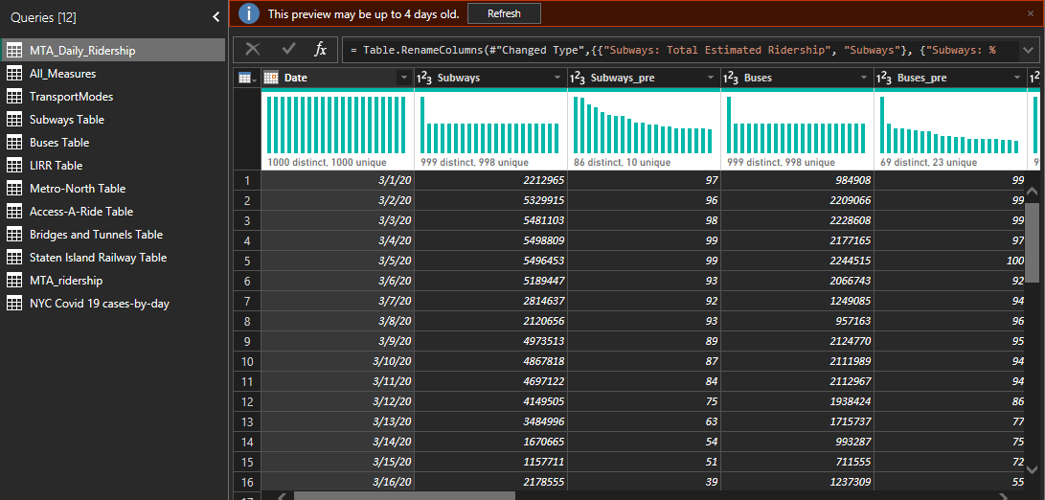
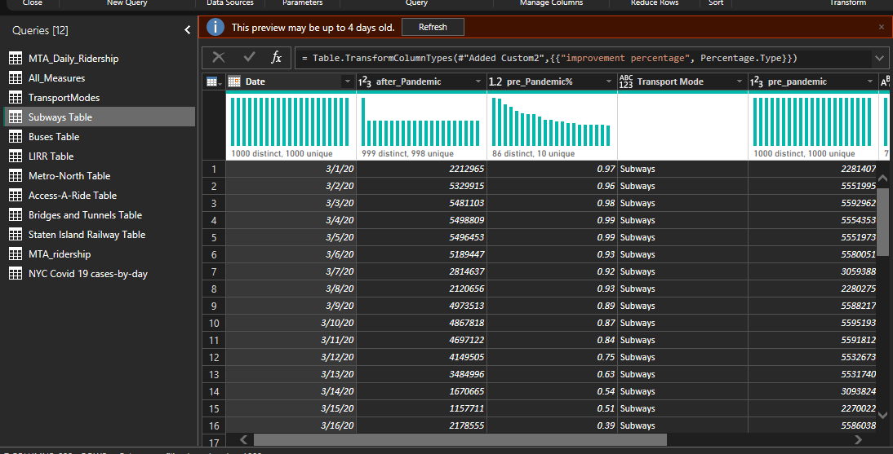
Project Building: 1- Data Cleaning & modeling & DAXs
- Data Cleaning
- Table Cutting
- Create Column in PQ
- Create relations
- Create Measures

Slide 12
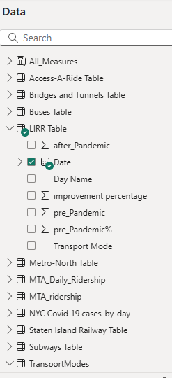
Project Building: 1- Data Cleaning & modeling & DAXs
- Data Cleaning
- Table Cutting
- Create Column in PQ
- Create relations
- Create Measures

Slide 13
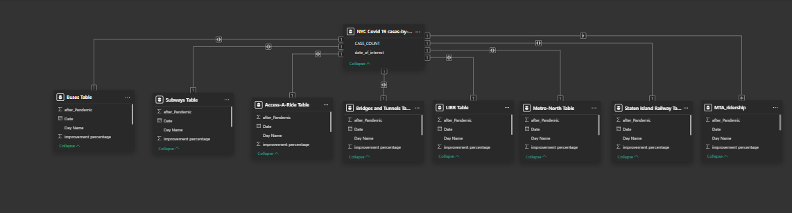
Project Building: 1- Data Cleaning & modeling & DAXs
- Data Cleaning
- Table Cutting
- Create Column in PQ
- Create relations
- Create Measures

Slide 14
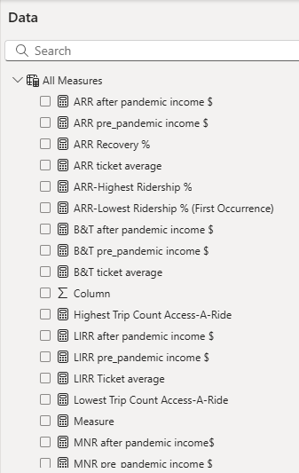
Project Building: 1- Data Cleaning & modeling & DAXs
- Data Cleaning
- Table Cutting
- Create Column in PQ
- Create relations
- Create Measures

Slide 15


Project Building: 3- Visuals (main+7 Visuals)
B&T
NYCT
LIRR
ARR
MTABC
SIR
MNR

Slide 16
B&T
NYCT
LIRR
B&T
ARR
MTABC
SIR
MNR

Slide 17
B&T
NYCT
LIRR
B&T
ARR
MTABC
SIR
MNR

Slide 18
B&T
NYCT
LIRR
B&T
ARR
MTABC
SIR
MNR

Slide 19
B&T
NYCT
LIRR
B&T
ARR
MTABC
SIR
MNR

Slide 20
B&T
NYCT
LIRR
B&T
ARR
MTABC
SIR
MNR

Slide 21
B&T
NYCT
LIRR
ARR
MTABC
SIR
MNR

Slide 22
services
history
teams
B&T
timeline
ARR
MTABC
NYCT
MNR
SIR
LIRR

Slide 23
services
history
teams
B&T
timeline
ARR
MTABC
NYCT
MNR
SIR
LIRR

Slide 24
services
history
teams
B&T
timeline
ARR
NYCT
MNR
MTABC
SIR
LIRR

Slide 25
services
history
teams
B&T
timeline
ARR
NYCT
MNR
MTABC
SIR
LIRR

Slide 26
MTABC
history
services
teams
ARR
B&T
NYCT
timeline
MNR
SIR
LIRR

Slide 27
MTABC
history
services
teams
ARR
B&T
NYCT
timeline
MNR
SIR
LIRR

Slide 28
MTABC
history
services
teams
B&T
timeline
ARR
NYCT
MNR
SIR
LIRR

Slide 29
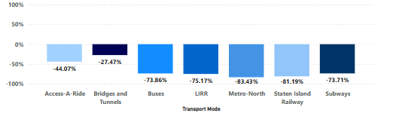
Key Insights from the MTA for year 2020
In 2020, MTA experienced a decline in ridership across all six subsidiaries, as well as in the ARR service. The least affected company was MTA B&T, which is understandable due to the COVID-19 pandemic. People relied more on private transportation to reduce the spread of the virus, avoiding public transit options such as buses and subways.

Slide 30
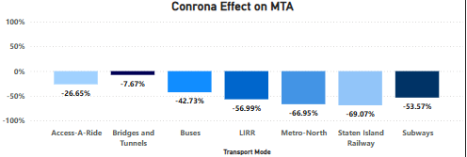
Key Insights from the MTA for year 2021
In 2021, all services showed a clear gradual improvement with the beginning of the decline in the spread of the COVID-19 virus.

Slide 31
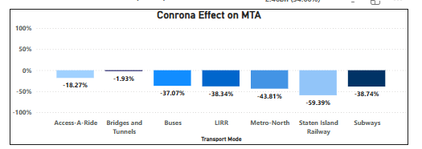
Key Insights from the MTA for year 2022
In 2022, all services showed a clear gradual improvement from 2021 with the beginning of the decline in the spread of the COVID-19 virus.

Slide 32
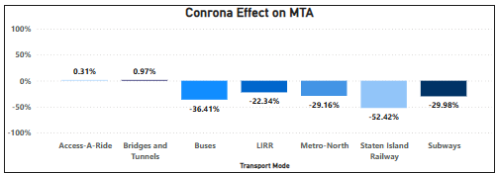
Key Insights from the MTA for year 2023
In 2023, all services showed a clear gradual improvement with the beginning of the decline in the spread of the COVID-19 virus. And ARR & B&T are achieving positive improvement after three years of loss.

Slide 33
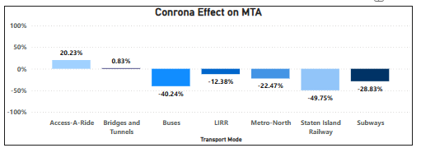
Key Insights from the MTA for year 2024
In 2024, all services showed a slight positive improvement. But Buses & B&T slightly decreased in improvement

Slide 34
Key Insights from the MTA for year 2024 & future idea
Why MTA showed a slight positive improvement and Buses & B&T show slightly decreased in improvement in 2024 ?
Frist problem:- In August 2024, the MTA raised subway and bus fares from $2.75 to $2.90 — the first increase since 2015. Bridge and tunnel tolls also increased by up to 10%, which may influence riders' decisions to use public transportation. Link
✅ Possible Solutions:
Introduce discounted fare programs for low-income riders (e.g., expand Fair Fares NYC).
Cap daily/weekly fares to make frequent travel more affordable (similar to London’s Oyster system).
Offer loyalty incentives like free rides after X number of trips in a week.
Use fare increases specifically for visible improvements (e.g., announce what part of service is being funded to gain public support).
.

Slide 35
Key Insights from the MTA for year 2024 & future idea
Second problem:-In April 2024, downtown shuttle bus service was suspended due to ridership dropping to less than half of pre-pandemic levels, reflecting a shift in commuting patterns. Link
✅ Possible Solutions:
Replace underused routes with micro transit or on-demand shuttles using smaller vehicles.
Pilot commuter vans or partnerships with ride-hailing services during off-peak hours.
Run community outreach programs to understand why ridership dropped and how to regain it.
Real-time route optimization using rider app check-ins and AI to adjust service dynamically
& future idea

Slide 36
Key Insights from the MTA for year 2024 & future idea
Third problem:-The beginning of 2024 saw a 47% increase in the number of passengers traveling on the main subway line compared to the previous year, resulting in the deployment of 750 National Guard personnel to enhance security. Link
✅ Possible Solutions:
Expand off-peak and express service to spread demand throughout the day.
Increase station staff and visible presence of MTA police, not just National Guard.
Install more cameras, panic buttons, and lighting in trains and platforms.
Create rider education campaigns on safety, crowding, and off-peak benefits.
.

Slide 37
.
Key Insights from the MTA for year 2024 & future idea
Forth problem:-The MTA is facing a financial deficit estimated at $25 billion, which affects its plans to modernize infrastructure, including replacing aging subway cars and improving signal systems. Link
✅ Possible Solutions:
Explore real estate development around stations (e.g., transit-oriented development).
Apply for climate-related federal grants by positioning upgrades as sustainable infrastructure

Slide 38
Thanks
We would like to express our sincere gratitude to DEPI for managing and presenting these valuable courses, providing us with an excellent learning experience.
A special thanks to CLS for their support in providing skilled instructors who have guided us throughout the training.
Most importantly, We extend our deepest appreciation to Instructor Wael Gomaa for his dedication, expertise, and insightful teaching, which have significantly enriched our knowledge. Your efforts are truly appreciated, and we are grateful for this opportunity to learn and grow. Thank you!

Slide 39
Thank You

